Slide 1
Assessment Support (Qualitative)
Laura Perry

Slide 2
Outline of the session
Two parts:
Taught section: Go through the requirements of the assessment
Independent Work and 1-to-1 Support: Time to work on the assessment and receive 1-to-1 support from the AM.

Slide 3
Assessment Overview
Description: 750-word template on the critical appraisal of a research article using qualitative research methodology.
Weighting: 50%
Deadline: ​Friday 8th May 2026 at 3pm

Slide 4
Mentimeter

Slide 5
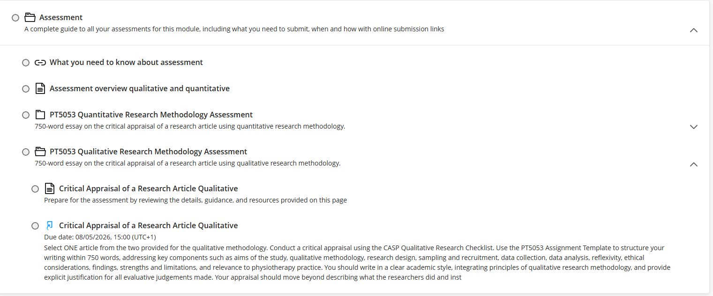
Assessment Information

Slide 6


Steps to completing the assessment
Step 1: Pick your article if you haven’t already (Qualitative Study 1 OR Qualitative Study 2)
OR

Slide 7


Steps to completing the assessment
Step 2: Complete the CASP (for Qualitative Research) for your chosen Qualitative Study (Qualitative Study 1 OR Qualitative Study 2)

Slide 8
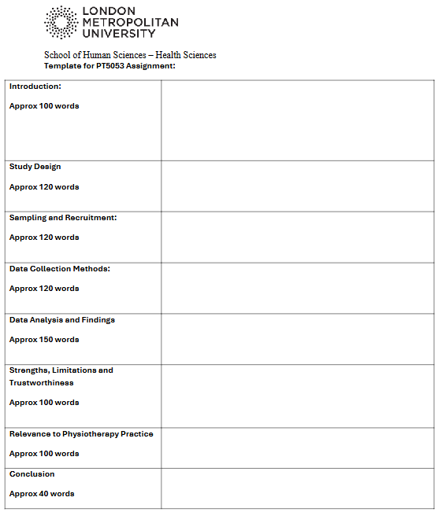
Steps to completing the assessment
Step 3: Download and complete the ‘Template STUDENT PT5053.docx’ based on your chosen Qualitative Study and the CASP you have completed.
Notes:
Structured Assignment Sections
The PT5053 template divides assignments into clear sections with suggested word counts for structured completion.
Alignment With Marking Scheme
Following the template ensures alignment with the marking criteria, improving organization and academic clarity.
Common Errors to Avoid
Avoid errors like misplaced content, overly descriptive writing, missing references, and insufficient critique.
Maintaining Concise Content
Focus on concise, focused writing within each section to prevent overlap and maintain clarity in the assignment.

Slide 9
Steps to completing the assessment
Step 4: Add your completed CASP (Qualitative Research) as an appendix to your Template STUDENT PT5053.docx
Key Points for Appendices:
Appendices should appear after the reference list.
Appendices should be referred to within the main text (e.g., ‘See Appendix A for the completed CASP for Qualitative Research’)
Each appendix should be labelled with a letter in alphabetical order (Appendix A, Appendix B, etc.).
Each appendix should have a clear title describing its contents.

Slide 10
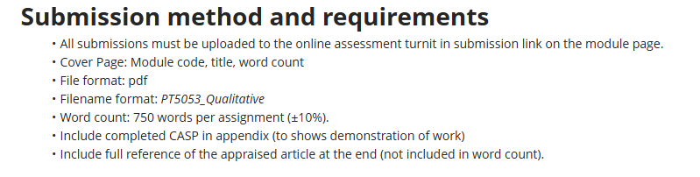
Steps to completing the assessment
Step 5: Ensure you adhere to the submission method and requirements:

Slide 11
Further Information
For information on
How to create a title page/cover sheet
How to save as a pdf
Please refer to the previous assessment support PowerPoint
You must ensure that your work falls within the required word count of 750 words ±10% (i.e., 675–825 words).
Submit to Weblearn before Friday 8th May 2026 at 3pm

Slide 12
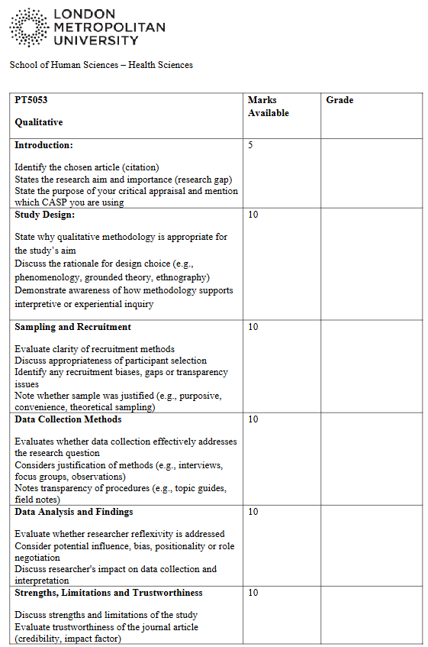
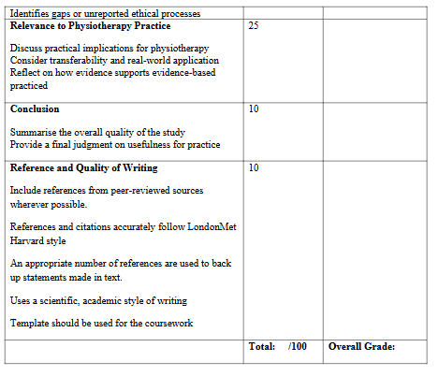
Marking Scheme – Group Discussion
Task – Download/open the template to complete/improve/take notes

Slide 13
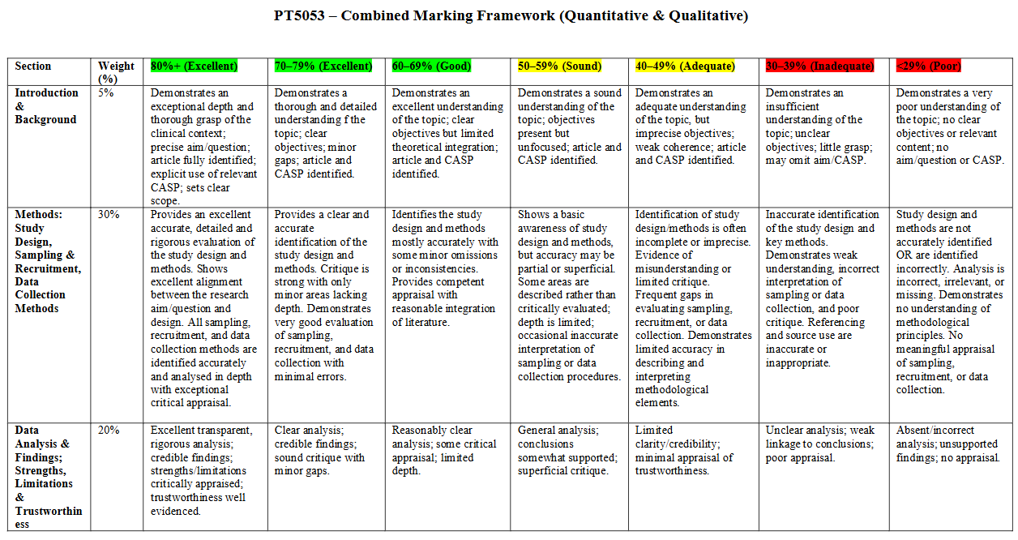
Marking Rubric

Slide 14
AI Declaration (Show on Weblearn)
Appropriate and inappropriate use are detailed on Weblearn

Slide 15
Final Tips
Be critical, not descriptive
Be concise
Ensure all content is placed in the correct section of the template.

Slide 16
Any Questions on Part 1?
Deadline: Friday 8th May 2026 at 3pm

Slide 17
Break (10-15 minutes)

Slide 18
Part 2: Independent Work and 1-to-1 Support

Slide 19
Reminder: Drop In Session
I will be running a drop‑in session on:
📅 Thursday 30th April
⏰ 11:00–13:00
📍 T11‑06 (11th floor of the Tower building)
This is another opportunity to get support with your first assessment. Please bring any drafts or questions you have.
The drop‑in will operate on a first‑come, first‑served basis. Attendance at the drop-in session is optional.

